Slide 1
Python and Instance-based learning (Memory-based learning)
From Real Python
https://realpython.com/knn-python/#knn-is-a-supervised-machine-learning-algorithm

Slide 2
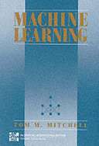
K Nearest Neighbors
預測某一案例(x)的目標數值(f(x))
找到離x最近的k個鄰居案例(以距離函數)
以k個鄰居的目標值f(x1), f(x2)…f(xk)來估算f(x) (平均值或是投票)
K-Nearest neighbor (by Tom Michelle)
Given xq, take vote among its k nearest nbrs if Discrete-valued target function.
take mean of f values of k nearest nbrsif Real-valued

Slide 3
Properties
kNN Is a Supervised Machine Learning Algorithm
kNN Is a Nonlinear Learning Algorithm
kNN Is Fast and Interpretable
kNN is less likely to perform well on advanced tasks like computer vision and natural language processing.

Slide 4
Use kNN to Predict the Age of Sea Slugs
see Real Python
https://realpython.com/knn-python/#knn-is-a-supervised-machine-learning-algorithm

Slide 5
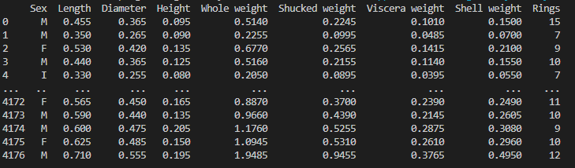
Problem description
The age of an abalone can be found by cutting its shell and counting the number of rings on the shell.

Slide 6
Import data
import pandas as pd #使用pandas進行表格處理
url = ("https://archive.ics.uci.edu/ml/machine-learning-databases/abalone/abalone.data")
abalone = pd.read_csv(url, header=None) #讀取網路上的表格
abalone.columns = [ ‘Sex', 'Length', 'Diameter', 'Height', 'Whole weight','Shucked weight','Viscera weight','Shell weight','Rings'] #加上欄位名稱
print(abalone) #列印表格

Slide 7
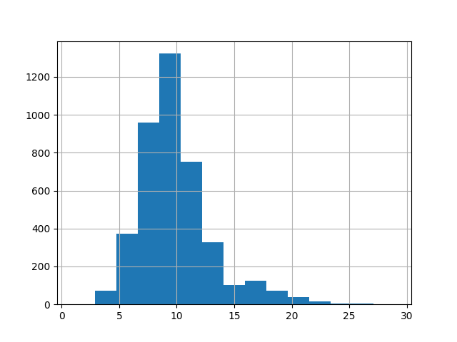
統計Ring的分佈圖(Histogram)
import matplotlib.pyplot as plt #使用matplatlib製圖
abalone[‘Rings’].hist(bins=15) # 以Rings為橫軸，統計個案數，列出做多15條
plt.show()

Slide 8
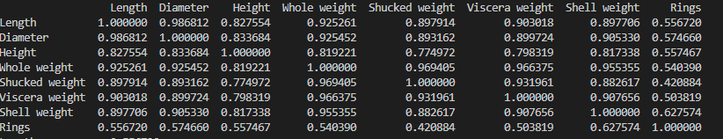
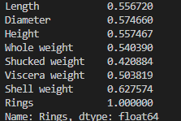
計算相關性
abalone2= abalone.drop('Sex',axis=1)
#去掉sex字串欄位
correlation_matrix = abalone2.corr() #計算相關矩陣
print(correlation_matrix)
print(correlation_matrix[“Rings”]) #僅取Rings的相關指數

Slide 9
Fitting a kNN Regression in scikit-learn to the Abalone Dataset

Slide 10
將資料集分割
將資料集分割
Training data is used to fit the model. For kNN, this means that the training data will be used as neighbors.
Test data is used to evaluate the model. It means that you’ll make predictions for the number of rings of each of the abalones in the test data and compare those results to the known true number of rings.

Slide 11
將資料集分割
X = abalone.drop("Rings", axis=1) #取Rings欄位以外的所有資料
X = X.drop("Sex", axis=1) #刪除Sex欄位
X = X.values #僅取數值，不取欄位名稱
y = abalone["Rings"] #取Rings欄位的資料
y = y.values #僅取數值，不取欄位名稱
from sklearn.model_selection import train_test_split
# 將兩個(attribute與預測值)大的案例庫，按比例切割成信鍊與測試資料集
X_train, X_test, y_train, y_test = train_test_split(X, y, test_size=0.2, random_state=12345)

Slide 12
開始訓練kNN regression model
from sklearn.neighbors import KNeighborsRegressor
knn_model = KNeighborsRegressor(n_neighbors=3) #使用kNN(k=3)來訓練
knn_model.fit(X_train, y_train) #使用kNN(k=3)來訓練

Slide 13
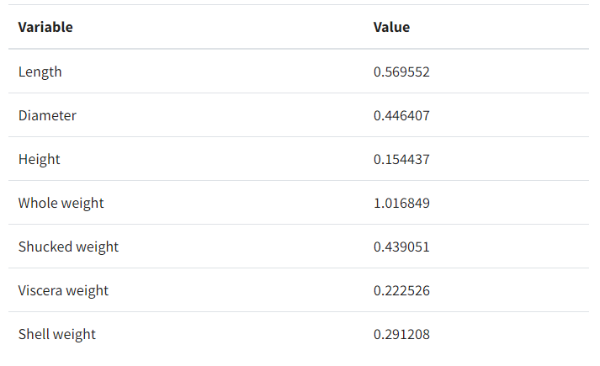
產生新的案例
假設你想用kNN預測左邊的新案例的Rings
因此做出一個案例
import numpy as np
new_data_point = np.array([
0.569552,
0.446407,
0.154437,
1.016849,
0.439051,
0.222526,
0.291208,
])

Slide 14
使用訓練的模型預測Rings
sci_learn_prediction = knn_model.predict([new_data_point])
print("Sci Learn prediction:")
print(sci_learn_prediction)

Slide 15
自做kNN預測器

Slide 16
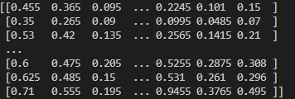
準備案例資料
X = abalone.drop("Rings", axis=1) #取Rings欄位以外的所有資料
X = X.drop("Sex", axis=1) #刪除Sex欄位
X = X.values #僅取數值，不取欄位名稱
y = abalone["Rings"] #取Rings欄位的資料
y = y.values #僅取數值，不取欄位名稱
X
y

Slide 17
產生新的案例
假設你想用kNN預測左邊的新案例的Rings
因此做出一個案例
new_data_point = np.array([
0.569552,
0.446407,
0.154437,
1.016849,
0.439051,
0.222526,
0.291208,
])

Slide 18
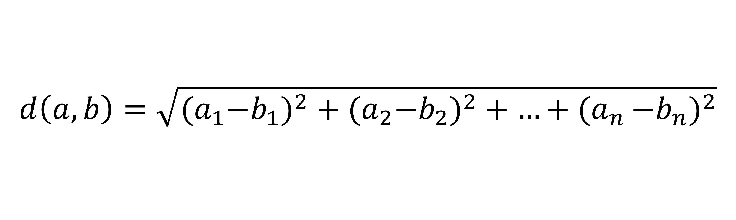
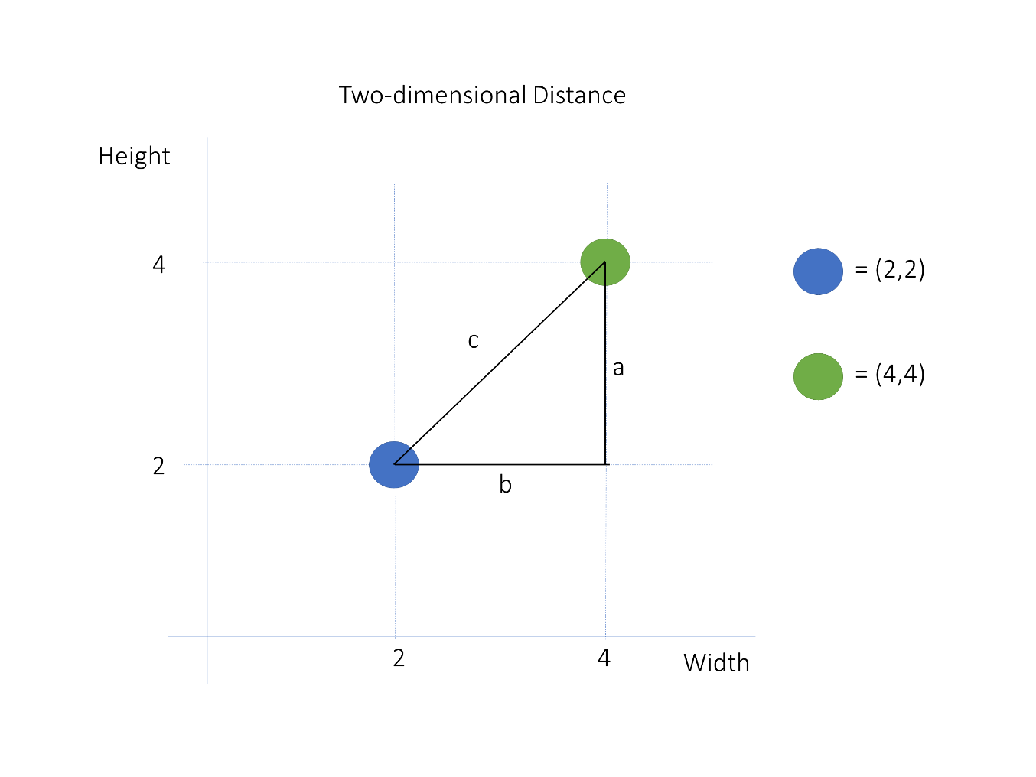
計算兩案例的距離
You can compute this in Python using linalg.norm() from NumPy:
import numpy as np
a = np.array([2, 2])
b = np.array([4, 4])
print(np.linalg.norm(a - b))

Slide 19
計算新案例與資料案例的距離
distances=np.linalg.norm(X-new_data_point, axis=1) #計算資料案例與新案例的距離list
print(distances)

Slide 20
選取最近的k個案例
k = 3
nearest_neighbor_ids = distances.argsort()[:k] #排序距離list並取前k個案例
print(nearest_neighbor_ids) #列印出離新案例最近的k個案例的index

Slide 21
以最近的k個案例的Rings平均數目來預測
nearest_neighbor_rings = y[nearest_neighbor_ids] #根據取出的最近的k個案例的index，取出這些案例的Rings
#數目(list)
prediction = nearest_neighbor_rings.mean()
#取最近的k個案例Rings數目(list)的平均值
print(prediction)

